Slide 1
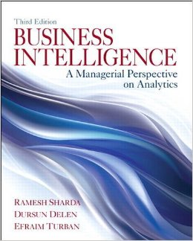
Business Intelligence: A Managerial Approach (3rd Edition)
Chapter 2:
Data Warehousing

Slide 2
Learning Objectives
Understand the basic definitions and concepts of data warehouses
Describe the processes used in developing and managing data warehouses
Explain data warehousing operations

Slide 3
Learning Objectives
Explain the role of data warehouses in decision support
Explain data integration and the extraction, transformation, and load (ETL) processes
Describe real-time (a.k.a. right-time and/or active) data warehousing

Slide 4
Database Design 101
Need a little background on Databases before we start discussing Data Warehouses!
Databases are primarily constructed from:
Tables (aka Entities)
Columns (Attributes)
Primary Key (PK)
Relationships
Introduces Foreign Key (FK)

Slide 5
A Table (Entity)
Something that user’s track (e.g., person, place, object, event, concept)
Represented in Entity Relationship diagram by a rectangle
An instance is a particular occurrence of an entity or a
Row in a table
Entity Type
Instance of the Entity
0010
Scott George
56 Neat Street
Boulder, Colorado
35882-2799
507-293-8749
CUSTOMER

Slide 6
Table Columns (Attributes)
A property or characteristic of an entity
A discrete data element
i.e. what do we want to keep track of for a Customer &
Every individual thing gets stored individually
CUSTOMER
Customer_Number
Last_Name
First_Name
Address
City
State
Zip
Phone
This Customer entity has eight attributes
Notes:
Attributes are contextual – they are items of interest to a specific organization. What one org wants to track, another might not care about.

Slide 7
Primary Keys
Criteria for Selecting a Key
Will not change in value
Will not be null
Substitute new, simple keys for long, composite keys
Create an identifier if there is no obvious identifying attribute (e.g., part number)

Slide 8
Relationships
A relationship is a link or association between the instances of one or more entities
The degree of a relationship indicates the number of entities involved
The cardinality of a relationship describes the minimum and maximum number of instances of one entity associated with another entity

Slide 9
Relationships - Examples
1 to 1
Parking Place
Employee
Product Line
1 to Many
Product
Many to Many
Student
Course

Slide 10
Good Design Standards for OLTP Databases
Each Table is designed to accumulate data about one type of thing
i.e. the columns help describe the attributes of that table and no other table
Data for one thing is stored in only one place
Don’t want CustomerLastName stored in multiple tables.
If a value changes or gets deleted, you would have to alter it everywhere and we don’t need a fishing expedition.
The better the table structure the fewer problems we have.
The process of making the tables better is called “Normalization”
1st Normal Form
2nd Normal Form
3rd Normal Form… etc.
Optimized for input/update/deleting data
Notes:
Normalization is the process of organizing data in a database. This includes creating tables and establishing relationships between those tables and establishing relationships between those tables according to rules designed both to protect the data and to make the database more flexible by eliminating redundancy and inconsistent dependency.

Slide 11
Example
Let’s build a DB in SQL Server!

Slide 12
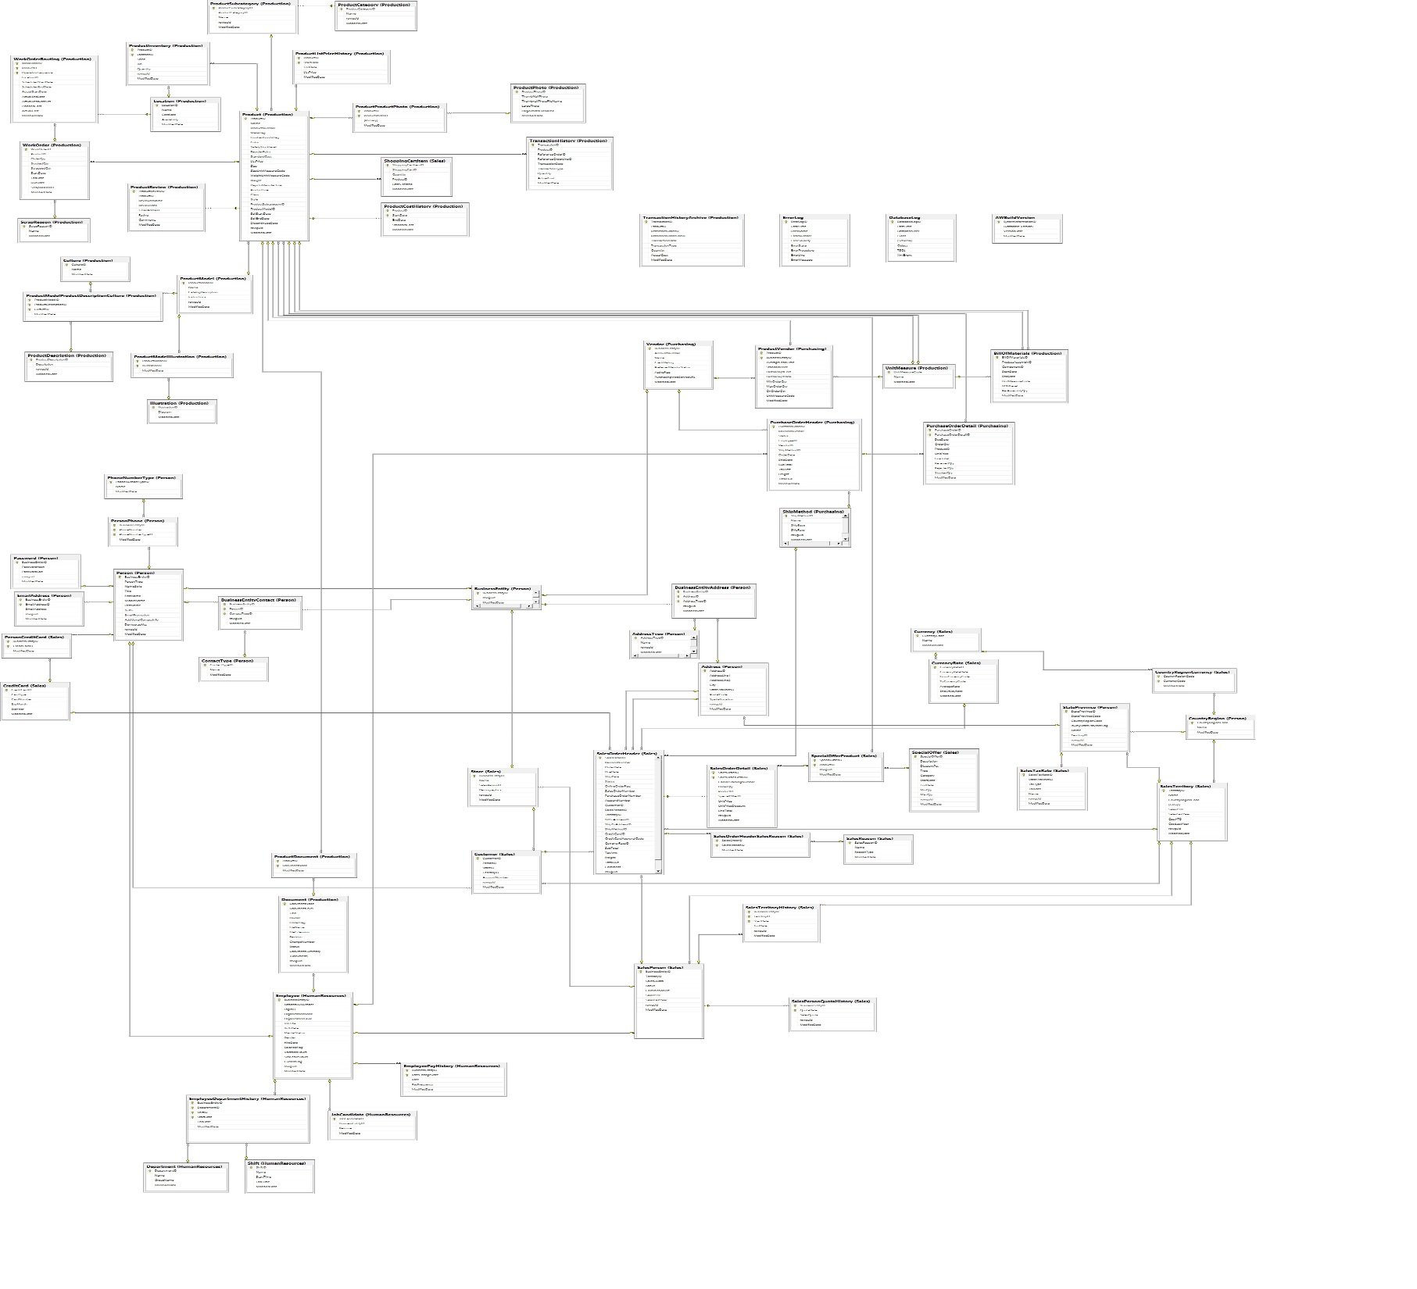

Slide 13
Good Design Standards for Data Warehouses
One version of the truth. It should only go into the warehouse if it is RIGHT
There should never have to be any need to update data since it is always correct!
Data can be duplicated in different tables for speed
Since data never gets updated or deleted, we don’t care if it is in different places
Optimized for retrieving data as quickly as possible
Fewer tables
Fact and Dimension tables

Slide 14
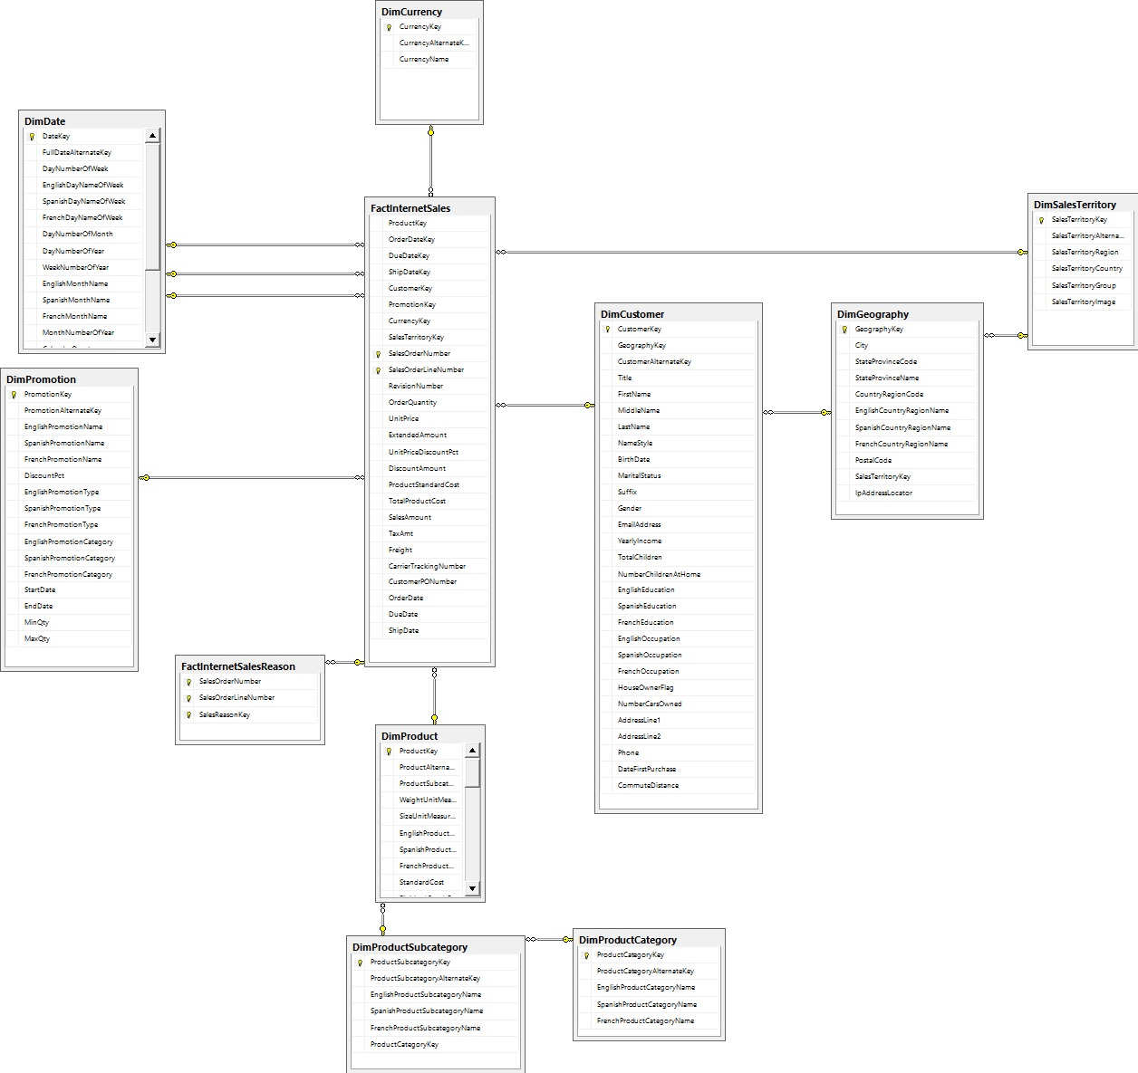

Slide 15
Main Data Warehousing Topics
DW definition
Characteristics of DW
Data Marts
ODS, EDW, Metadata
DW Framework
DW Architecture & ETL (Extract/Transfer/Load) Process
DW Development
DW Issues

Slide 16
What is a Data Warehouse?
A physical repository where relational data are specially organized to provide enterprise-wide, cleansed data in a standardized format
“The data warehouse is a collection of integrated, subject-oriented databases designed to support DSS functions, where each unit of data is non-volatile and relevant to some moment in time”
Notes:
DSS: Decision Support System

Slide 17
A Historical Perspective to Data Warehousing

Slide 18
Opening Vignette…
Isle of Capri Casinos Is Winning
with Enterprise Data Warehouse
Company background
Problem description
Proposed solution
Results

Slide 19
Questions for the Opening Vignette
Why is it important for Isle to have an EDW?
What were the business challenges or opportunities that Isle was facing?
What was the process Isle followed to realize EDW? Comment on the potential challenges Isle might have had going through the process of EDW development.
What were the benefits of implementing an EDW at Isle? Can you think of other potential benefits that were not listed in the case?
Why do you think large enterprises like Isle in the gaming industry can succeed without having a capable data warehouse/business intelligence infrastructure?

Slide 20
Characteristics of DW
Subject oriented
Integrated
Time-variant (time series)
Nonvolatile
Summarized
Not normalized
Metadata
Web based, relational/multi-dimensional
Client/server
Real-time and/or right-time (active)
Notes:
Subject oriented can mean different departmental views and views queried from specific product characteristics, for example. For example, to learn more about your company's sales data, you can build a warehouse that concentrates on sales. Using this warehouse, you can answer questions like "Who was our best customer for this item last year?" This ability to define a data warehouse by subject matter, sales in this case, makes the data warehouse subject oriented.
Nonvolatile: the data does not change.
Metadata: data about the data. Examples: data types, data dictionary that describes table attributes,
Time variant is a data warehouse’s focus on change over time

Slide 21
Data Mart
A departmental data warehouse that stores only relevant data
Dependent data mart
A subset that is created directly from a data warehouse
Independent data mart
A small data warehouse designed for a strategic business unit or a department
Notes:
Independent data marts don’t contribute much to BI because they are separate and blah…. Operational data store is where copying, manipulating, aggregation, etc of all data mart data goes to before going into data warehouse.

Slide 22
Data Warehousing Definitions
Operational data stores (ODS)
A type of database often used as an interim area for a data warehouse
Enterprise data warehouse (EDW)
A data warehouse for the enterprise
Metadata
Data about data. In a data warehouse, metadata describe the contents of a data warehouse and the manner of its acquisition and use

Slide 23
DW Framework

Slide 24
DW Architecture
Three-tier architecture
Data acquisition software (back-end)
The data warehouse that contains the data & software
Client (front-end) software that allows users to access and analyze data from the warehouse
Two-tier architecture
First 2 tiers in three-tier architecture is combined into one
Sometimes there is only one tier
Notes:
Architecture and tiers will not be covered much in this class.

Slide 25
DW Architectures
3-tier
architecture
2-tier
architecture
1-tier
Architecture

Slide 26
A Web-based DW Architecture

Slide 27
Data Warehousing Architectures
Issues to consider when deciding which architecture to use:
Which database management system (DBMS) should be used?
Will parallel processing and/or partitioning be used?
Will data migration tools be used to load the data warehouse?
What tools will be used to support data retrieval and analysis?

Slide 28
Alternative DW Architectures

Slide 29
Alternative DW Architectures
Each has pros and cons!
Which one is best???

Slide 30
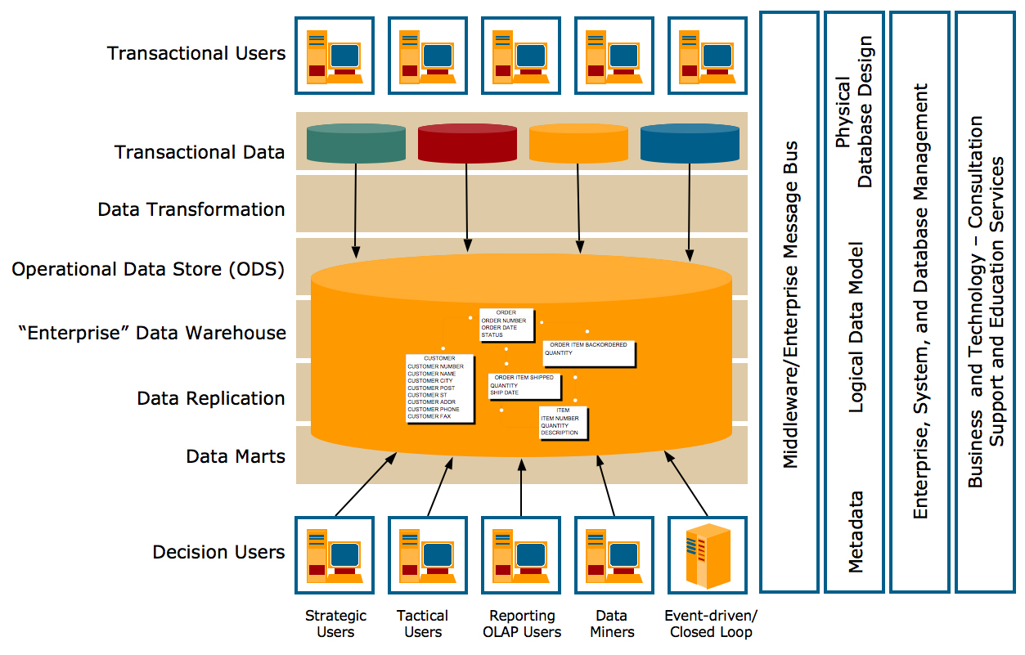
Teradata Corp. DW Architecture

Slide 31
Data Warehousing Architectures
Ten factors that potentially affect the architecture selection decision:
Information interdependence between organizational units
Upper management’s information needs
Urgency of need for a data warehouse
Nature of end-user tasks
Constraints on resources
Strategic view of the data warehouse prior to implementation
Compatibility with existing systems
Perceived ability of the in-house IT staff
Technical issues
Social/political factors

Slide 32
Data Integration and the Extraction, Transformation, and Load (ETL) Process
Data integration
Integration that comprises three major processes: data access, data federation, and change capture
Enterprise application integration (EAI)
A technology that provides a vehicle for pushing data from source systems into a data warehouse
Enterprise information integration (EII)
An evolving tool space that promises real-time data integration from a variety of sources, such as relational databases, Web services, and multidimensional databases

Slide 33
Data Integration and the Extraction, Transformation, and Load (ETL) Process
Extraction, transformation, and load (ETL)

Slide 34
ETL
Issues affecting the purchase of ETL tool
Stand-alone data transformation tools can be expensive
but then again, you may have already purchased it and not even know it!
Data transformation tools may have a long learning curve
Tools typically require specialized database administrator (DBA) skills
Important criteria in selecting an ETL tool
Ability to read from and write to an unlimited number of data sources/architectures
Automatic capturing and delivery of metadata
A history of conforming to open standards
An easy-to-use interface for the developer and the functional user

Slide 35
Data Warehouse Development
Data warehouse development approaches
Inmon Model: EDW approach (top-down)
Kimball Model: Data mart approach (bottom-up)
Which model is best?
There is no one-size-fits-all strategy to DW
One alternative is the hosted warehouse
Data warehouse structure:
The Star Schema vs. Relational
Real-time data warehousing?
Notes:
Note the differences between top-down and bottom-up approaches.

Slide 36
Hosted Data Warehouses
Benefits:
Requires minimal investment in infrastructure
Frees up capacity on in-house systems
Frees up cash flow
Makes powerful solutions affordable
Enables powerful solutions that provide for growth
Offers better quality equipment and software
Provides faster connections
Enables users to access data remotely
Allows a company to focus on core business
Meets storage needs for large volumes of data

Slide 37
Representation of Data in DW
Dimensional Modeling – a retrieval-based system that supports high-volume query access
Star schema – the most commonly used and the simplest style of dimensional modeling
Contain a fact table surrounded by and connected to several dimension tables
Fact table contains the descriptive attributes (numerical values) needed to perform decision analysis and query reporting
Dimension tables contain classification and aggregation information about the values in the fact table
Snowflakes schema – an extension of star schema where the diagram resembles a snowflake in shape

Slide 38
Multidimensionality
Multidimensionality
The ability to organize, present, and analyze data by several dimensions, such as sales by region, by product, by salesperson, and by time (four dimensions)
Multidimensional presentation
Dimensions: products, salespeople, market segments, business units, geographical locations, distribution channels, country, or industry
Measures: money, sales volume, head count, inventory profit, actual versus forecast
Time: daily, weekly, monthly, quarterly, or yearly

Slide 39
Star vs Snowflake Schema

Slide 40
Analysis of Data Stored in DW OLTP vs. OLAP
OLTP (online transaction processing)
A system that is primarily responsible for capturing and storing data related to day-to-day business functions such as
ERP (Enterprise Resource Planning)
CRM (Customer Relationship Mgmt)
SCM (Supply Chain Mgmt)
POS (Point of Sale transactions)
The main focus is on efficiency of routine tasks
OLAP (Online analytical processing)
Converting data into information for decision support
Data cubes, drill-down / rollup, slice & dice
Requesting ad hoc reports
Conducting statistical and other analyses
Developing multimedia-based applications
The main focus is on effectiveness

Slide 41
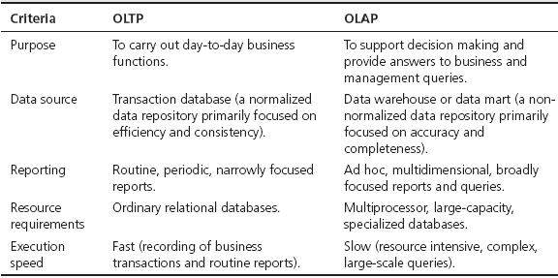
OLAP vs. OLTP

Slide 42
OLAP Operations
Slice – a subset of a multidimensional array
Dice – a slice on more than two dimensions
Drill Down/Up – navigating among levels of data ranging from the most summarized (up) to the most detailed (down)
Roll Up – computing all of the data relationships for one or more dimensions
Pivot – used to change the dimensional orientation of a report or an ad hoc query-page display

Slide 43
OLAP
Slicing Operations on a Simple Tree-Dimensional
Data Cube

Slide 44
Variations of OLAP
Multidimensional OLAP (MOLAP)
OLAP implemented via a specialized multidimensional database (or data store) that summarizes transactions into multidimensional views ahead of time
Relational OLAP (ROLAP)
The implementation of an OLAP database on top of an existing relational database
Database OLAP and Web OLAP (DOLAP and WOLAP); Desktop OLAP,…

Slide 45
DW Implementation Issues
11 tasks for successful DW implementation
Establishment of service-level agreements and data-refresh requirements
Identification of data sources and their governance policies
Data quality planning
Data model design
ETL tool selection
Relational database software and platform selection
Data transport
Data conversion
Reconciliation process
Purge and archive planning
End-user support

Slide 46
DW Implementation Guidelines
Project must fit with corporate strategy & business objectives
There must be complete buy-in to the project by executives, managers, and users
It is important to manage user expectations about the completed project
The data warehouse must be built incrementally
Build in adaptability, flexibility and scalability
The project must be managed by both IT and business professionals
Only load data that have been cleansed and are of a quality understood by the organization
Do not overlook training requirements
Be politically aware

Slide 47
Successful DW Implementation Things to Avoid
Starting with the wrong sponsorship chain
Setting expectations that you cannot meet
Engaging in politically naive behavior
Loading the data warehouse with information just because it is available
Believing that data warehousing database design is the same as transactional database design
Choosing a data warehouse manager who is technology oriented rather than user oriented

Slide 48
Successful DW Implementation Things to Avoid - Cont.
Focusing on traditional internal record-oriented data and ignoring the value of external data and of text, images, etc.
Delivering data with confusing definitions
Believing promises of performance, capacity, and scalability
Believing that your problems are over when the data warehouse is up and running
Focusing on ad hoc data mining and periodic reporting instead of alerts

Slide 49
Failure Factors in DW Projects
Lack of executive sponsorship
Unclear business objectives
Cultural issues being ignored
Change management
Unrealistic expectations
Inappropriate architecture
Low data quality / missing information
Loading data just because it is available

Slide 50
Massive DW and Scalability
Scalability
The main issues pertaining to scalability:
The amount of data in the warehouse
How quickly the warehouse is expected to grow
The number of concurrent users
The complexity of user queries
Good scalability means that queries and other data-access functions will grow linearly with the size of the warehouse

Slide 51
Real-time/Active DW/BI
Enabling real-time data updates for real-time analysis and real-time decision making is growing rapidly
Push vs. Pull (of data)
Concerns about real-time BI
Not all data should be updated continuously
Mismatch of reports generated minutes apart
May be cost prohibitive
May also be infeasible

Slide 52
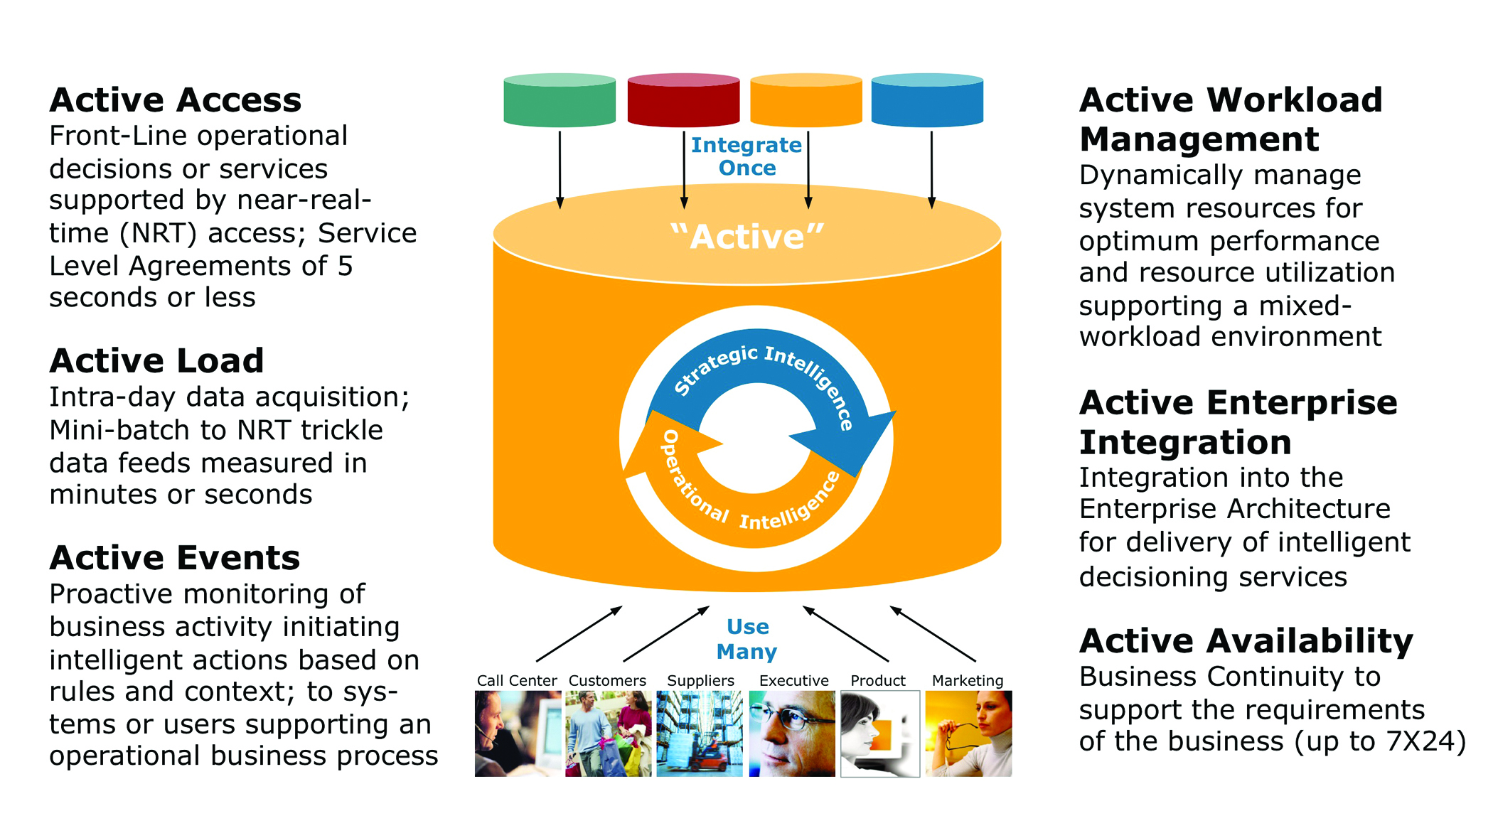
Real-time/Active DW at Teradata

Slide 53
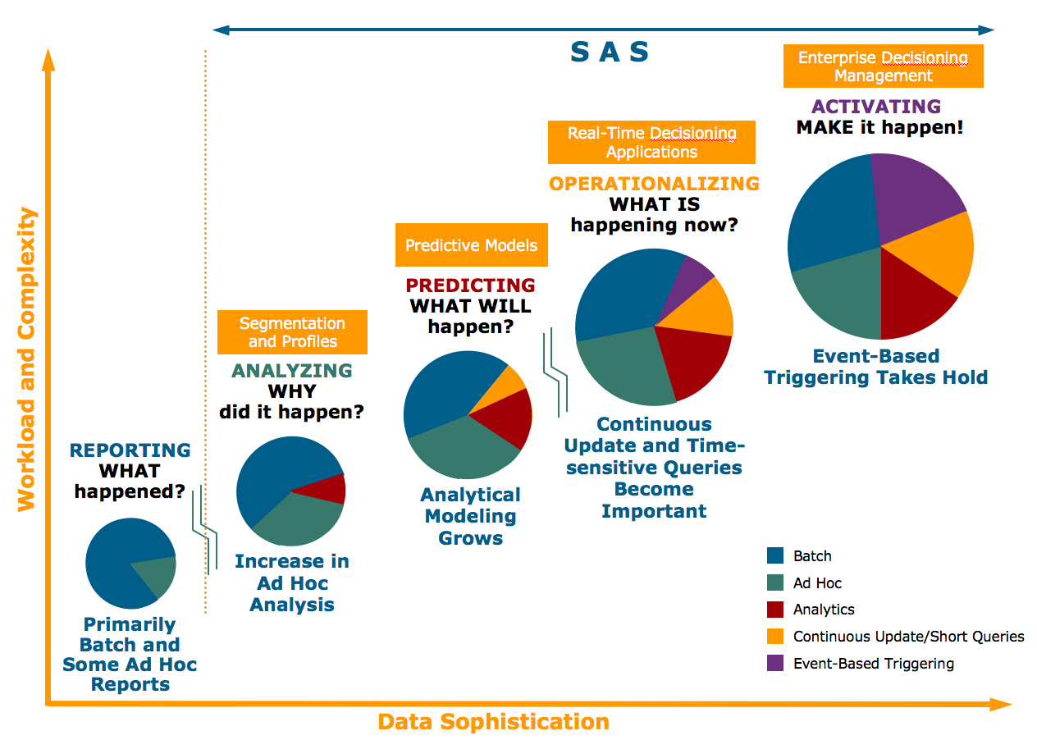
Enterprise Decision Evolution and DW

Slide 54
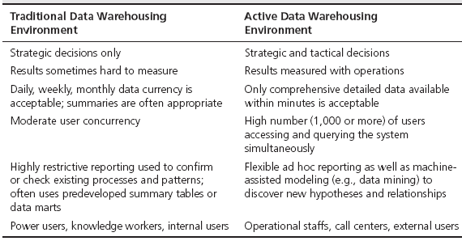
Traditional vs Active DW Environment

Slide 55
DW Administration and Security
Data warehouse administrator (DWA)
DWA should…
have the knowledge of high-performance software, hardware and networking technologies.
possess solid business knowledge and insight.
be familiar with the decision-making processes so as to suitably design/maintain the data warehouse structure.
possess excellent communications skills.
Security and privacy is a pressing issue in DW
Safeguarding the most valuable assets
Government regulations (HIPAA, etc.)
Must be explicitly planned and executed

Slide 56
The Future of DW
Sourcing…
Open source software
SaaS (software as a service)
Cloud computing
DW appliances
Infrastructure…
Columnar
Real-time DW
Data warehouse appliances
Data management practices/technologies
In-database & In-memory processing New DBMS
Advanced analytics

Slide 57
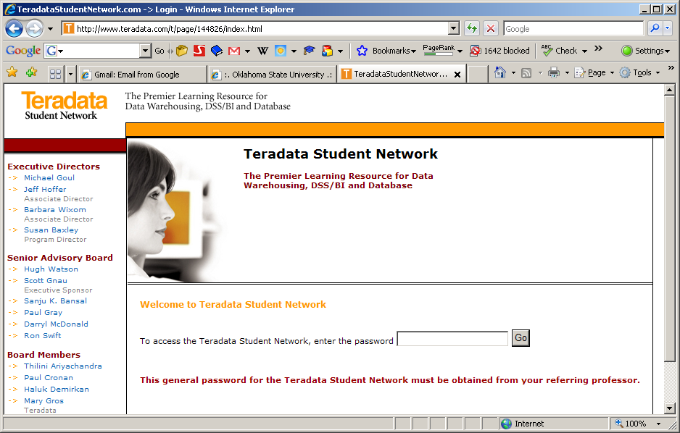
BI / OLAP Portal for Learning
MicroStrategy, and much more…
www.TeradataStudentNetwork.com
Pw: <check with TDUN>

Slide 58
End of the Chapter
Questions, comments

Slide 59
Let’s get pieces working for Labs
Teradata DB Server
Blackboard/Weekly Tasks/Lab Tutorials/Teradata Connection Instructions
Start / Remote Connection
ts-tun.waltoncollege.uark.edu
Options:
General Tab:username: walton\ES842XX
Local Resources tab
Printers, Clipboard, More C:
Advanced tab:
Connect from anywhere settings button
Use these RD Gateway server settings:
ent-sysgw.waltoncollege.uark.edu
Logon method: Allow me to select later

Slide 60
Let’s get pieces working for Labs
SQL Server 2012
Start/SQL Server
SQL Server Management Studio (SSMS)
Server Name: localhost
Authentication: Change to SQL Server Authentication
User Name: SA
Password: seminoles

